Slide 1
Project Presentation of Industry Oriented Hands on Experience (22CS422)
On
Federated Learning for Privacy-Preserving Collaborative AI: An Experimental Analysis of Data Distribution
Aniket (2210990114)
Akshit Sharma (2210990094)
Anmol Kaushik (2210990121)
Supervised By
Dr. Gurpreet Singh
Department of Computer Science and Engineering,
Chitkara University, Punjab

Slide 2
Introduction
• Machine learning traditionally uses centralized data
• This raises privacy and security concerns
• Federated Learning allows:
- Training without sharing raw data
- Decentralized model updates
• Key Problem:
- Data is not always evenly distributed (Non-IID)
• Objective:
- Compare centralized, IID FL, and Non-IID FL
2

Slide 3

Project Overview
• Built a Federated Learning simulation system
• Key Features:
- Multiple client simulation
- IID and Non-IID data handling
- Configurable training rounds
• Dataset Used:
- MNIST (handwritten digits)
• Model:
- Convolutional Neural Network (CNN)

Slide 4
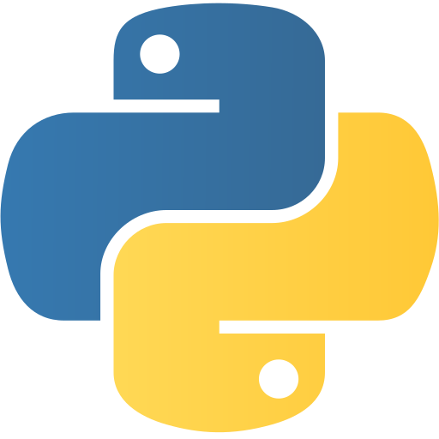


Technologies Used
• Programming Language:
- Python
• Machine Learning Framework:
- TensorFlow / Keras
• Data Handling:
- NumPy
• Visualization:
- Matplotlib
- Seaborn

Slide 5
Technologies Used
• Development Environment:
- Jupyter Notebook / Google Colab
• Dataset:
- MNIST (handwritten digits)
• Concept Used:
- Federated Learning (FedAvg Algorithm)

Slide 6

WORK / METHODOLOGY
• Centralized Model:
- Trained using full dataset
• Federated Learning:
- Data split across 3 clients
- Local training on each client
- FedAvg used for aggregation

Slide 7
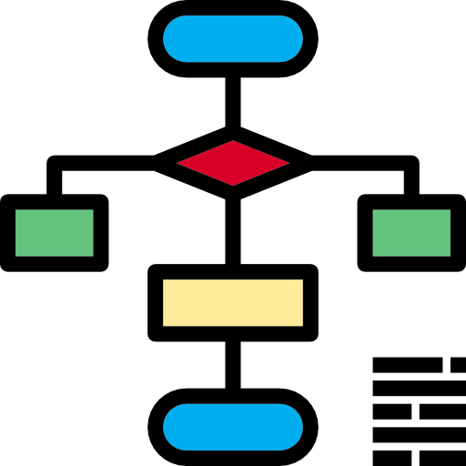
WORK / METHODOLOGY
• Two Scenarios:
- IID (balanced data)
- Non-IID (biased data)
• Evaluation:
- Accuracy
- Convergence behavior
- Training time

Slide 8
RESULTS
• Centralized Accuracy: ~99.15%
• IID Federated: ~99.19%
• Non-IID Federated: ~94.03%
Observations:
• IID ≈ Centralized performance
• Non-IID shows accuracy drop
• Training slower in federated setup
Key Insight:
• Data distribution directly impacts model performance

Slide 9
CONCLUSION
• Federated Learning is effective for privacy
• Works well when:
- Data is evenly distributed (IID)
• Challenges in Non-IID:
- Client drift
- Slower convergence
- Reduced accuracy
• Contribution:
- Built a configurable FL simulation system
- Demonstrated impact of data distribution

Slide 10
Thank You
6

